Slide 1
Session 13
Regression Testing
chengbaolei@suda.edu.cn

Slide 2
Objectives
In Session 12:
Unit testing
Integration testing
System testing
Acceptance testing
Regression testing

Slide 3
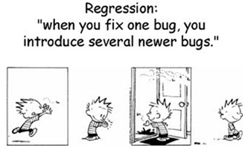
Why Regression Test?

Slide 4
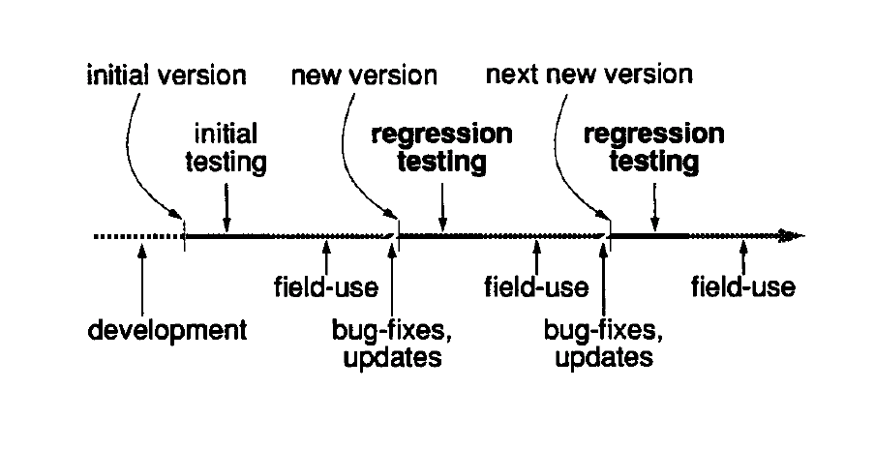
Why Regression Test?
expensive and frequently executed

Slide 5
What is Regression Testing?
Whenever changes happen to software, regression testing is performed to ensure that these changes are correct and they do not adversely affect the existing software.
It is necessary to perform regression testing when:
Defect fixing.
Change is in requirements and code is modified according to the requirement.
New feature is added to the software.

Slide 6
How to do Regression Testing
How much re-testing is needed?
Retest-all?
A set of selected test.
The test cases that failed due to the defects should be included for future regression testing.
An impact analysis is done to find out what areas may get impacted due to those defect fixes. Based on the impact analysis, some more test cases are selected to take care of the impacted areas.

Slide 7
How to do Regression Testing
SUT
Modification
Modification
Direct impact area
Add code
Modification
Indirect impact area

Slide 8
How to do Regression Testing
Program P
Test case prioritization
Old Test Suites
Additional
Test Suites
New
Test
Suites
Test case selection
+
=
(1) 从现有的测试用例集T中选出一个子集T’。
(2) 在修改后的代码P’上运行T’，用以确定P’的正确性。
(3) 建立新的测试用例集T’’。
(4) 在修改后的代码P’上运行T’’，用以确定P’的正确性。
(5) 由T, T’, T’’建立P’的测试历史和测试用例集T’’’
Program P’

Slide 9
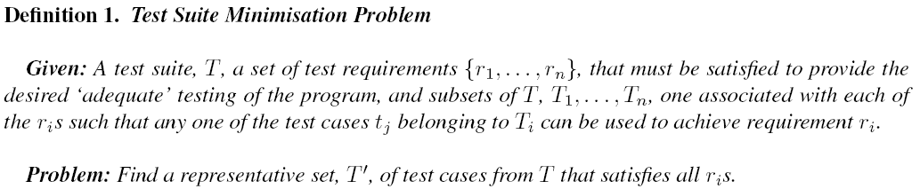
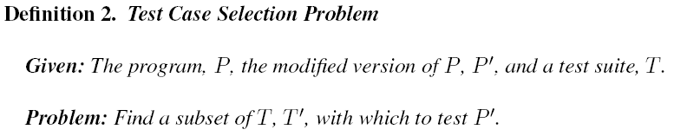
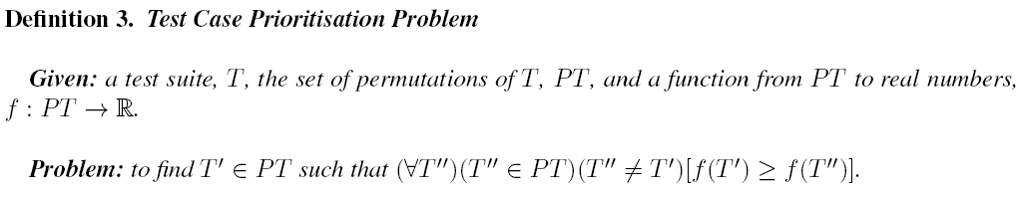
How to do Regression Testing

Slide 10
Test case minimization
Aim to identify redundant test cases and to remove them from the test suite in order to reduce the size of the test suite
Note that the minimal hitting set formulation of the test suite minimization problem depends on the assumption that each r_{i} can be satisfied by a single test case. In practice, this may not be true.

Slide 11
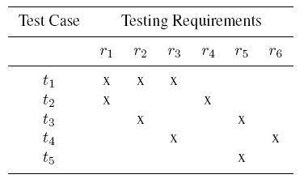
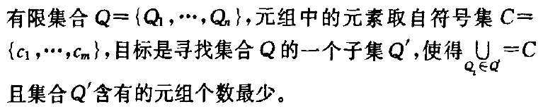
Test case minimization
最小化→NP-Hard

Slide 12
An example
Greedy: select the test case that satisfies the maximum number of test requirements. t1-t2-t3-t4
Additional Greedy: select the test case that satisfies the maximum number of unsatisfied test requirements. t1-t2-t3/t5-t4
GE: first select all essential test cases in the test suite; for the remaining test
requirements, use the additional greedy algorithm, i.e. select the test case that satisfies the maximum number of unsatisfied test requirements. t2-t4-t3
GRE heuristic: first remove all redundant test cases in the test suite, which may make some test cases essential; then perform the GE heuristic on the reduced test suite. t2-t4-t3

Slide 13
Exercise
 | r1 | r2 | r3 | r4 | r5
t1 | X
t2 |  | X | X | X | X
t3 |  | X |  | X | X
t4 |  |  | X | X | X
t5 |  |  | X
t6 |  |  |  | X | X

Slide 14


Test case minimization
The effectiveness of the minimization:
The impact of test suite minimization was measured by calculating the reduction in fault detection effectiveness as follows:

Slide 15
Test case selection
Reduce the number of test cases and satisfy the testing requirements.
Various test criteria
Fault detection ability
Code coverage
Time cost
Fault detection history
…
VS. test case minimization

Slide 16
Test case selection
Classify test cases into five classes. The first three classes consist of test cases which already exist in T.
Reusable: Reusable test cases execute the parts of the program that remain unchanged and common to program P and P’.
Re-testable: Re-testable test cases execute the parts of P that get changed in P’.
Obsolete
1) Their input/output relation get changed due to changes in specifications
2) They no longer test what they were designed to test due to modifications in the program
3) They are “structurally” test cases that no longer contribute to structural coverage of the program.

Slide 17
Test case selection
The remaining two classes consist of test cases that are to be generated for the regression testing of P’.
New-structural: New-structural test cases test the modified program constructs that provide structural coverage of the modified parts in P’.
New-specification: New-specification test cases test the modified program specifications.

Slide 18
Test case selection
Two execution traces ET(P(t)) and ET(P’(t)) are equivalent if they have the same lengths and if, when their elements are compared from first to last, the text representing the pairs of corresponding elements is lexicographically equivalent.
Two text strings are lexicographically equivalent if their text is identical.
Test t is modification-traversing for P and P’ if and only if ET(P(t)) and ET(P’ (t)) are nonequivalent.
Rothermel G , Harrold M J . A safe, efficient regression test selection technique[J]. ACM Transactions on Software Engineering and Methodology, 1997, 6(2):173-210.

Slide 19
Test case selection
Fault-revealing Test Cases
A test case t ∈ T is said to be fault-revealing for a program P, if and only if by executing this on program P, there is a failure due to incorrect output.
Modification-revealing Test Cases
A test case t ∈ T is considered to be modification-revealing for P and P′ if it produces different outputs for P and P′.
Modification-traversing Test Cases
A test case t ∈T is modification-traversing for P and P′ if and only if the execution traces of t on P and P′ are different.
A test case t is said to be modification-traversing if it executes the modified regions of code in P′.

Slide 20
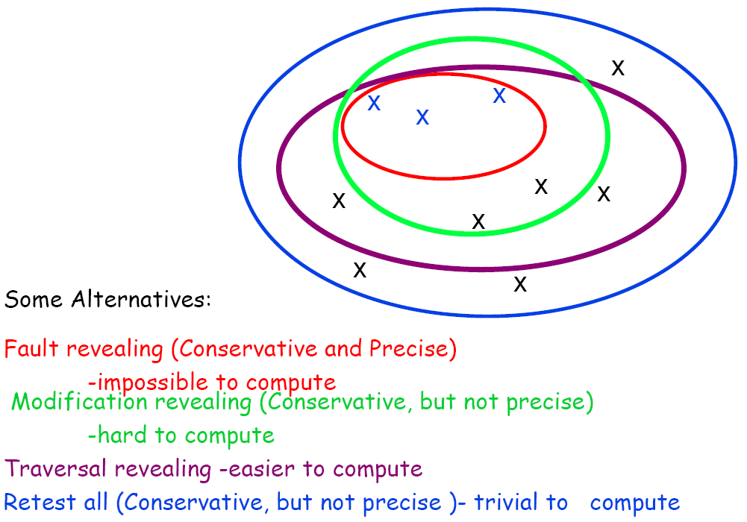
Test case selection

Slide 21
Test case selection
Inclusive, Precise and Safe Regression Test Cases:
Inclusive: Inclusiveness measure the extent to which we select modification revealing test cases from the original test suit T. Expressed as (m/n)*100.
Safe: selects all the modification revealing test cases. In other ways, if it is 100% inclusive then we said it a safe technique.
Precision: measure the extent to which regression test selection ignores the non modification revealing test cases.

Slide 22


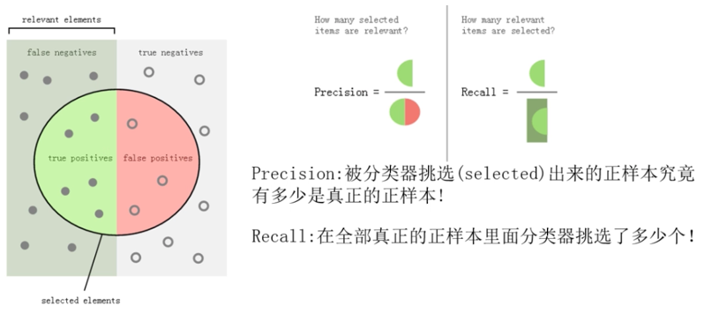
Test case selection
Evaluation Models
the number of test cases in the original test suite is T,
F_{T} test cases of them are fault-revealing.
A test selection technique selects a subset of T’ test cases, in which F_{T’} are fault-revealing.

Slide 23
Test case selection
Effective Regression Tests can be done by selecting following test cases -
Test cases which have frequent defects
Functionalities which are more visible to the users
Test cases which verify core features of the product
Test cases of Functionalities which has undergone more and recent changes
All Integration Test Cases
All Complex Test Cases
Boundary value test cases
Sample of Successful test cases
Sample of Failure test cases

Slide 24
Test case Prioritization
Test case prioritization seeks to find the ideal ordering of test cases for testing, so that the tester obtains maximum benefit, even if the testing is prematurely halted at some arbitrary point.

Slide 25

Test case Prioritization
Average Percentage of Fault Detection (APFD) metric.
Higher APFD values denote faster fault detection rates.
APFD can be calculated as the area below the plotted line.
let T be the test suite containing n test cases and let F be the set of m faults revealed by T. For ordering T₀, let TF_{i} be the order of the first test case that reveals the ith fault.

Slide 26
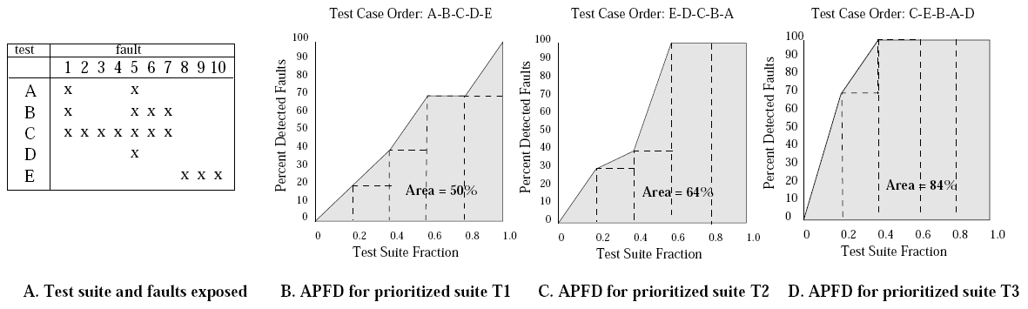
Test case Prioritization

Slide 27
Test case Prioritization
Khatibsyarbini, M.; Isa, M.A.; Jawawi, D.N.A.; Tumeng, R. Test case prioritization approaches in regression testing: a systematic literature. Information and Software Technology, v 93, p 74-93, Jan. 2018

Slide 28
When to do Regression Testing
Regular Execution (daily, weekly, monthly)
Perform in accordance with the regulations (after each change, after an important change, before the final version is released)
The regression test ends with:
All errors have been detected
Run all designed test cases
Exhaustion of resources
Project Expiration
…

Slide 29
Regression Testing Tools
Important tools used for both functional and regression testing:
Selenium: This is an open source tool used for automating web applications. Selenium can be used for browser based regression testing.
Quick Test Professional (QTP): HP Quick Test Professional is automated software designed to automate functional and regression test cases. It is a Data driven, Keyword based tool.
Rational Functional Tester (RFT): IBM's rational functional tester is a Java tool used to automate the test cases of software applications. This is primarily used for automating regression test cases and it also integrates with Rational Test Manager.

Slide 30
Comparison of concepts
Re-Testing and Regression Testing:
Retesting means testing the functionality or bug again to ensure the code is fixed. If it is not fixed, Defect needs to be re-opened. If fixed, Defect is closed.
Regression testing means testing your software application when it undergoes a code change to ensure that the new code has not affected other parts of the software.

Slide 31
Comparison of concepts
冒烟测试（smoke test）
可用性测试（sanity test）
BVT （Build Verification Test）
Both sanity tests and smoke tests are ways to avoid wasting time and effort by quickly determining whether an application is too flawed to merit any rigorous testing.

Slide 32
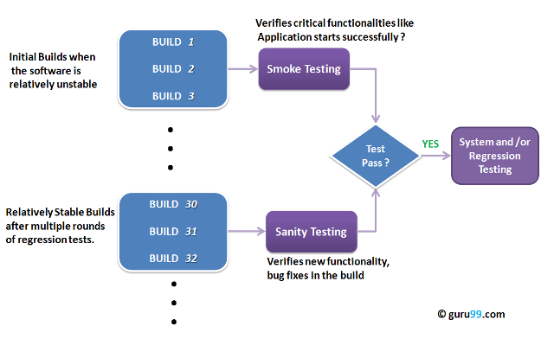

Slide 33
What is Smoke Testing?
To ascertain that the critical functionalities of the program is working fine.
It is executed "before" any detailed functional or regression tests are executed on the software build.
The purpose is to reject a badly broken application, so that the QA team does not waste time installing and testing the software application.

Slide 34
What is Smoke Testing?
A typical smoke test would be
Verify that the application launches successfully
Check that the GUI is responsive
...
“Hello, world ”

Slide 35
What is Sanity Testing?
After receiving a software build, with minor changes in code, or functionality, to ascertain that the bugs have been fixed and no further issues are introduced due to these changes.
If sanity test fails, the build is rejected to save the time and costs involved in a more rigorous testing.

Slide 36
What is Sanity Testing?
The objective is "not" to verify thoroughly the new functionality, but to determine that the developer has applied some rationality (sanity) while producing the software.
For instance, if your scientific calculator gives the result of 2 + 2 =5. Then, there is no point testing the advanced functionalities like sin 30 + cos 50.

Slide 37
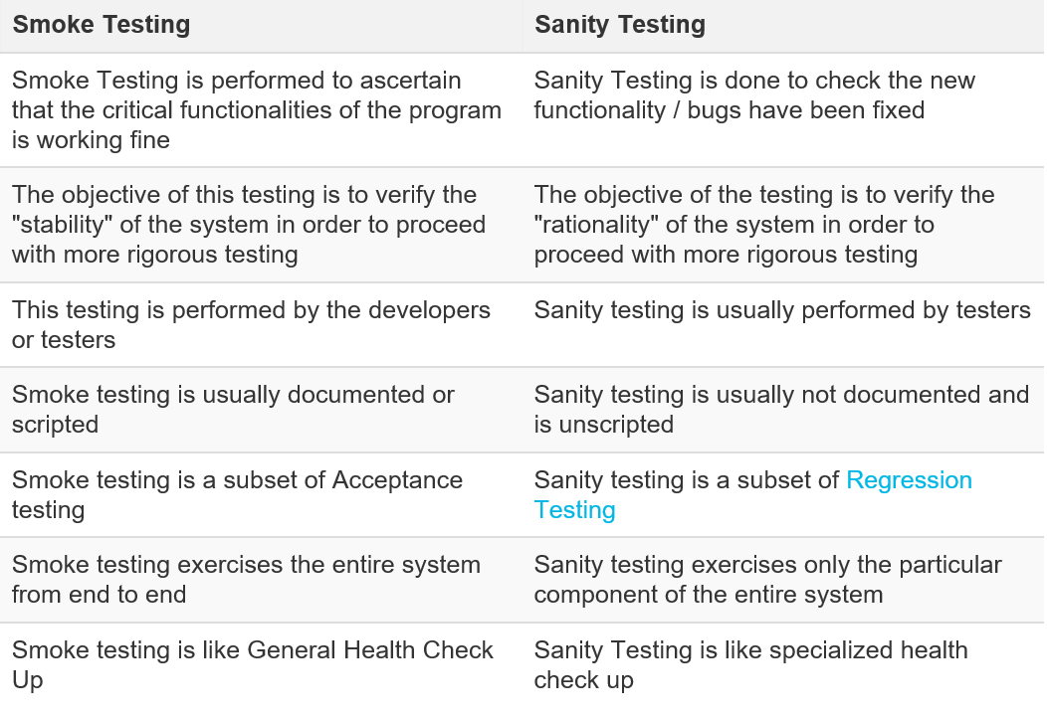
Smoke Testing Vs Sanity Testing - Key Differences
Tester acceptance testing
shallow and wide
narrow and deep

Slide 38
Points to note
One of the best industry practice is to conduct a Daily build and smoke test in software projects.
First execute Smoke tests and then go ahead with Sanity Testing.
In industry, test cases for Sanity Testing are commonly combined with that for smoke tests, to speed up test execution. Hence, it's a common that the terms are often confused and used interchangeably.

